Slide 1
Welcome!
Information Session about Active Membership
Committees:
Atlas Trip
Business Trip
Conference
Synergy Week
Photo
Kick-Off
Orientation Week
Ski Trip
Community
Magazine

Slide 2
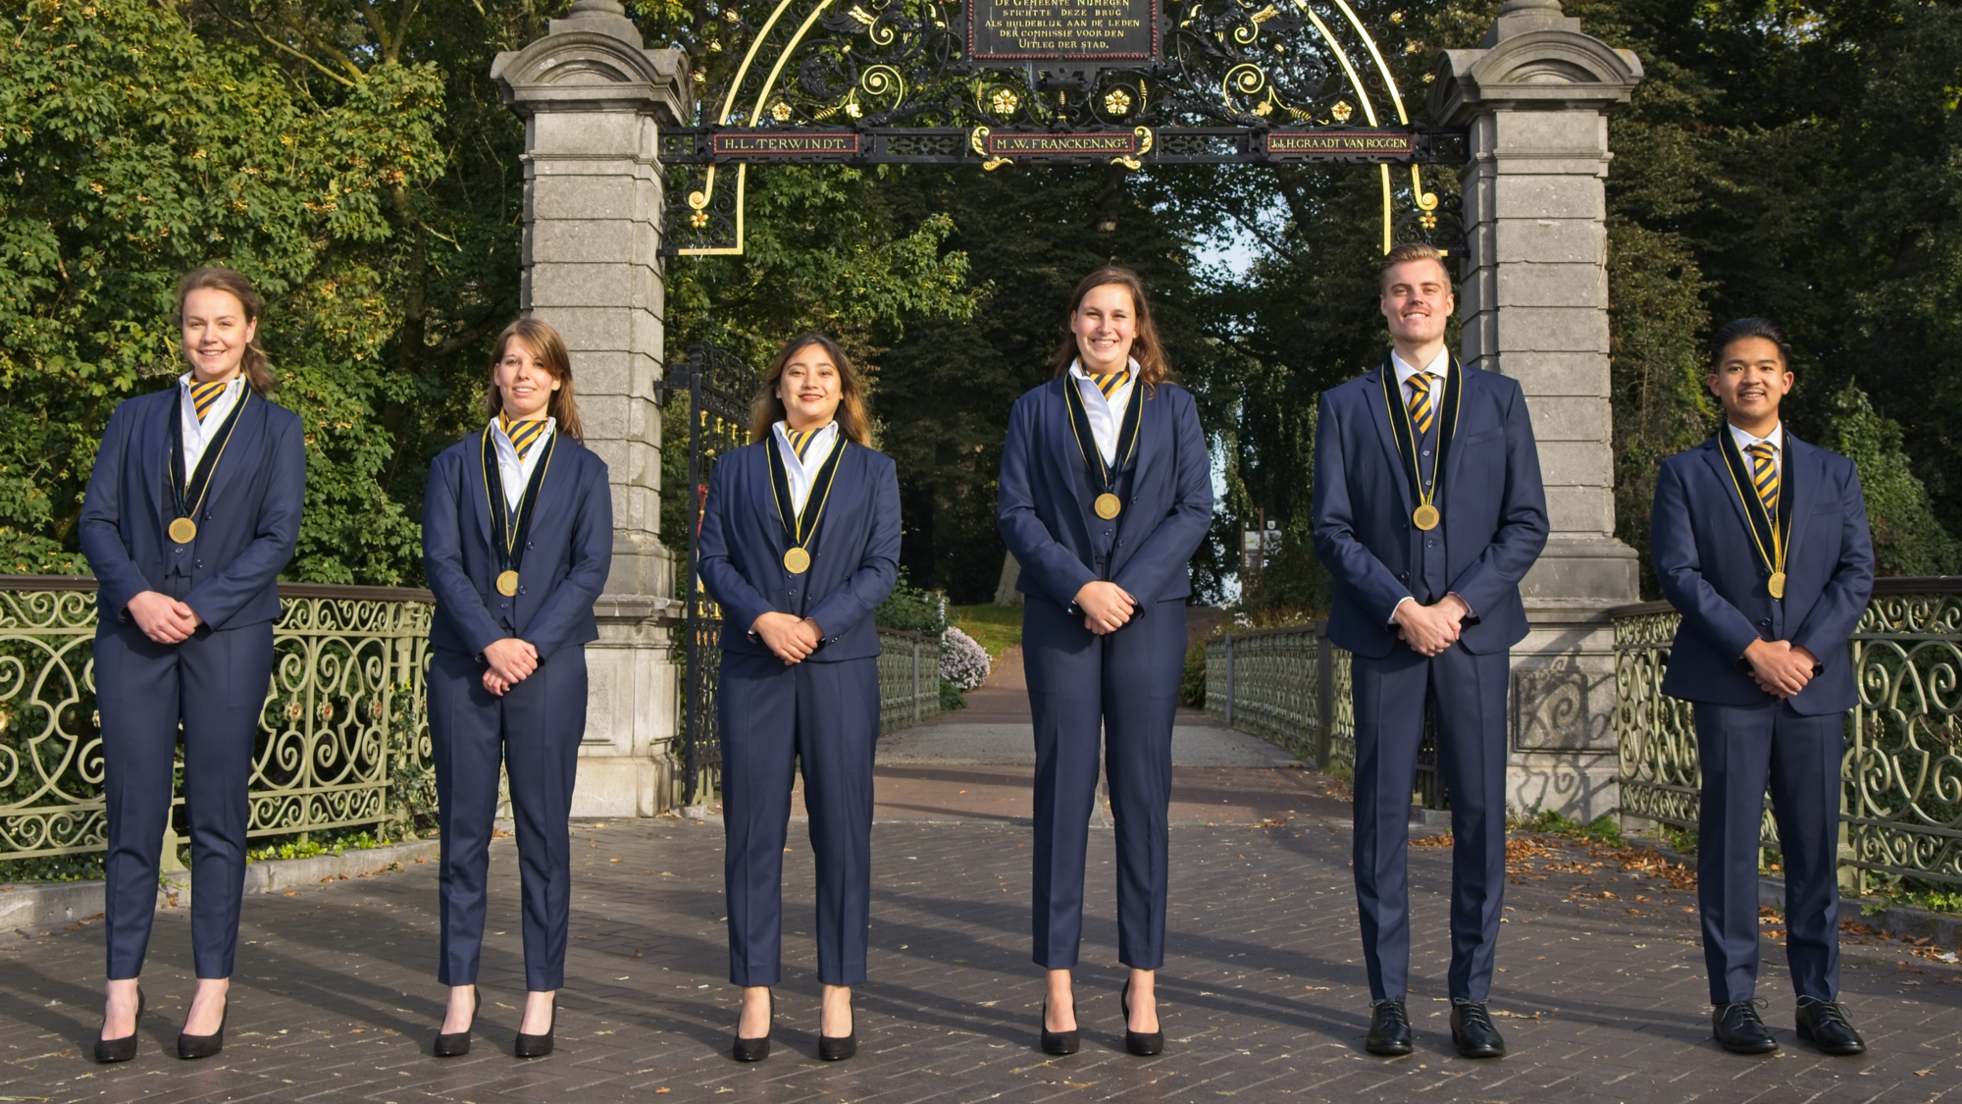
Introduction of the Synergy Board

Slide 3
Committees in general
Committees organize +/- 150 activities every year
Responsible for every aspect of the activity
Formal, informal, trips, support
Workload varies from 1 – 6 hours a week
Practical experience
Cooperate
Meet new people

Slide 4
Different positions
Chairman (letter of motivation)
Treasurer
Marketing Officer
Internal
External

Slide 5
Committees that start in February
Atlas Committee
Business Trip Committee
Conference Committee
Kick-Off Committee
Orientation Committee
Ski Trip Committee
Synergy Week Committee

Slide 6
Other available committees
Magazine Committee
Photo Committee
Formal Master Committee (chairman)
Community Committee

Slide 7
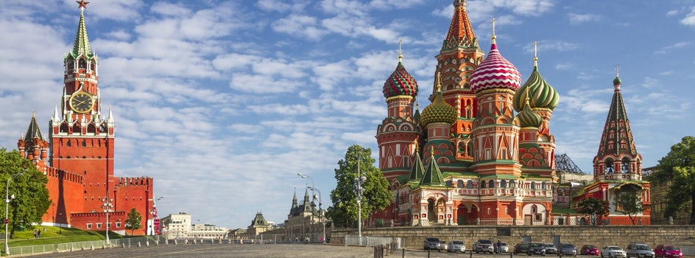
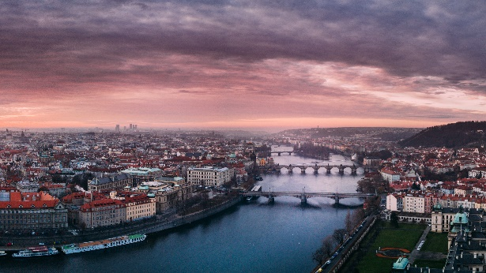
Atlas Committee
Yearly international trip for 40 people
7/8 days (April/May)
Company visits, cultural activities, clubbing
Foreign city!

Slide 8
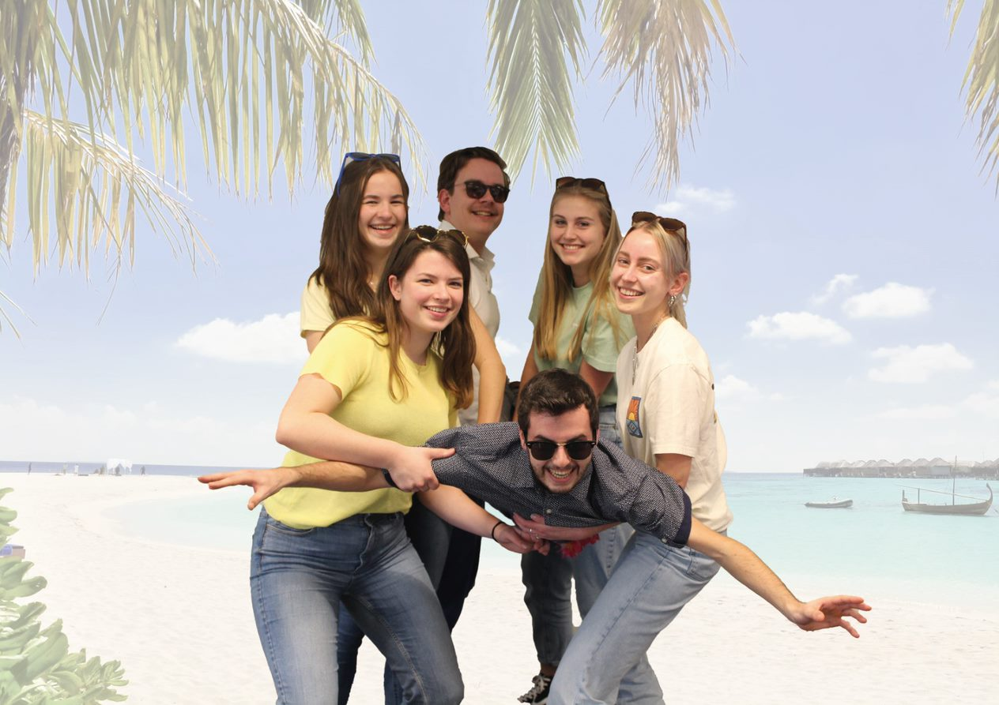
Atlas Committee
6 committee members (chairman, internal, external, treasurer)
Takes 1 hour a week at first
After summer increasing workload
Enthusiastic, brave committee
Good for your CV

Slide 9
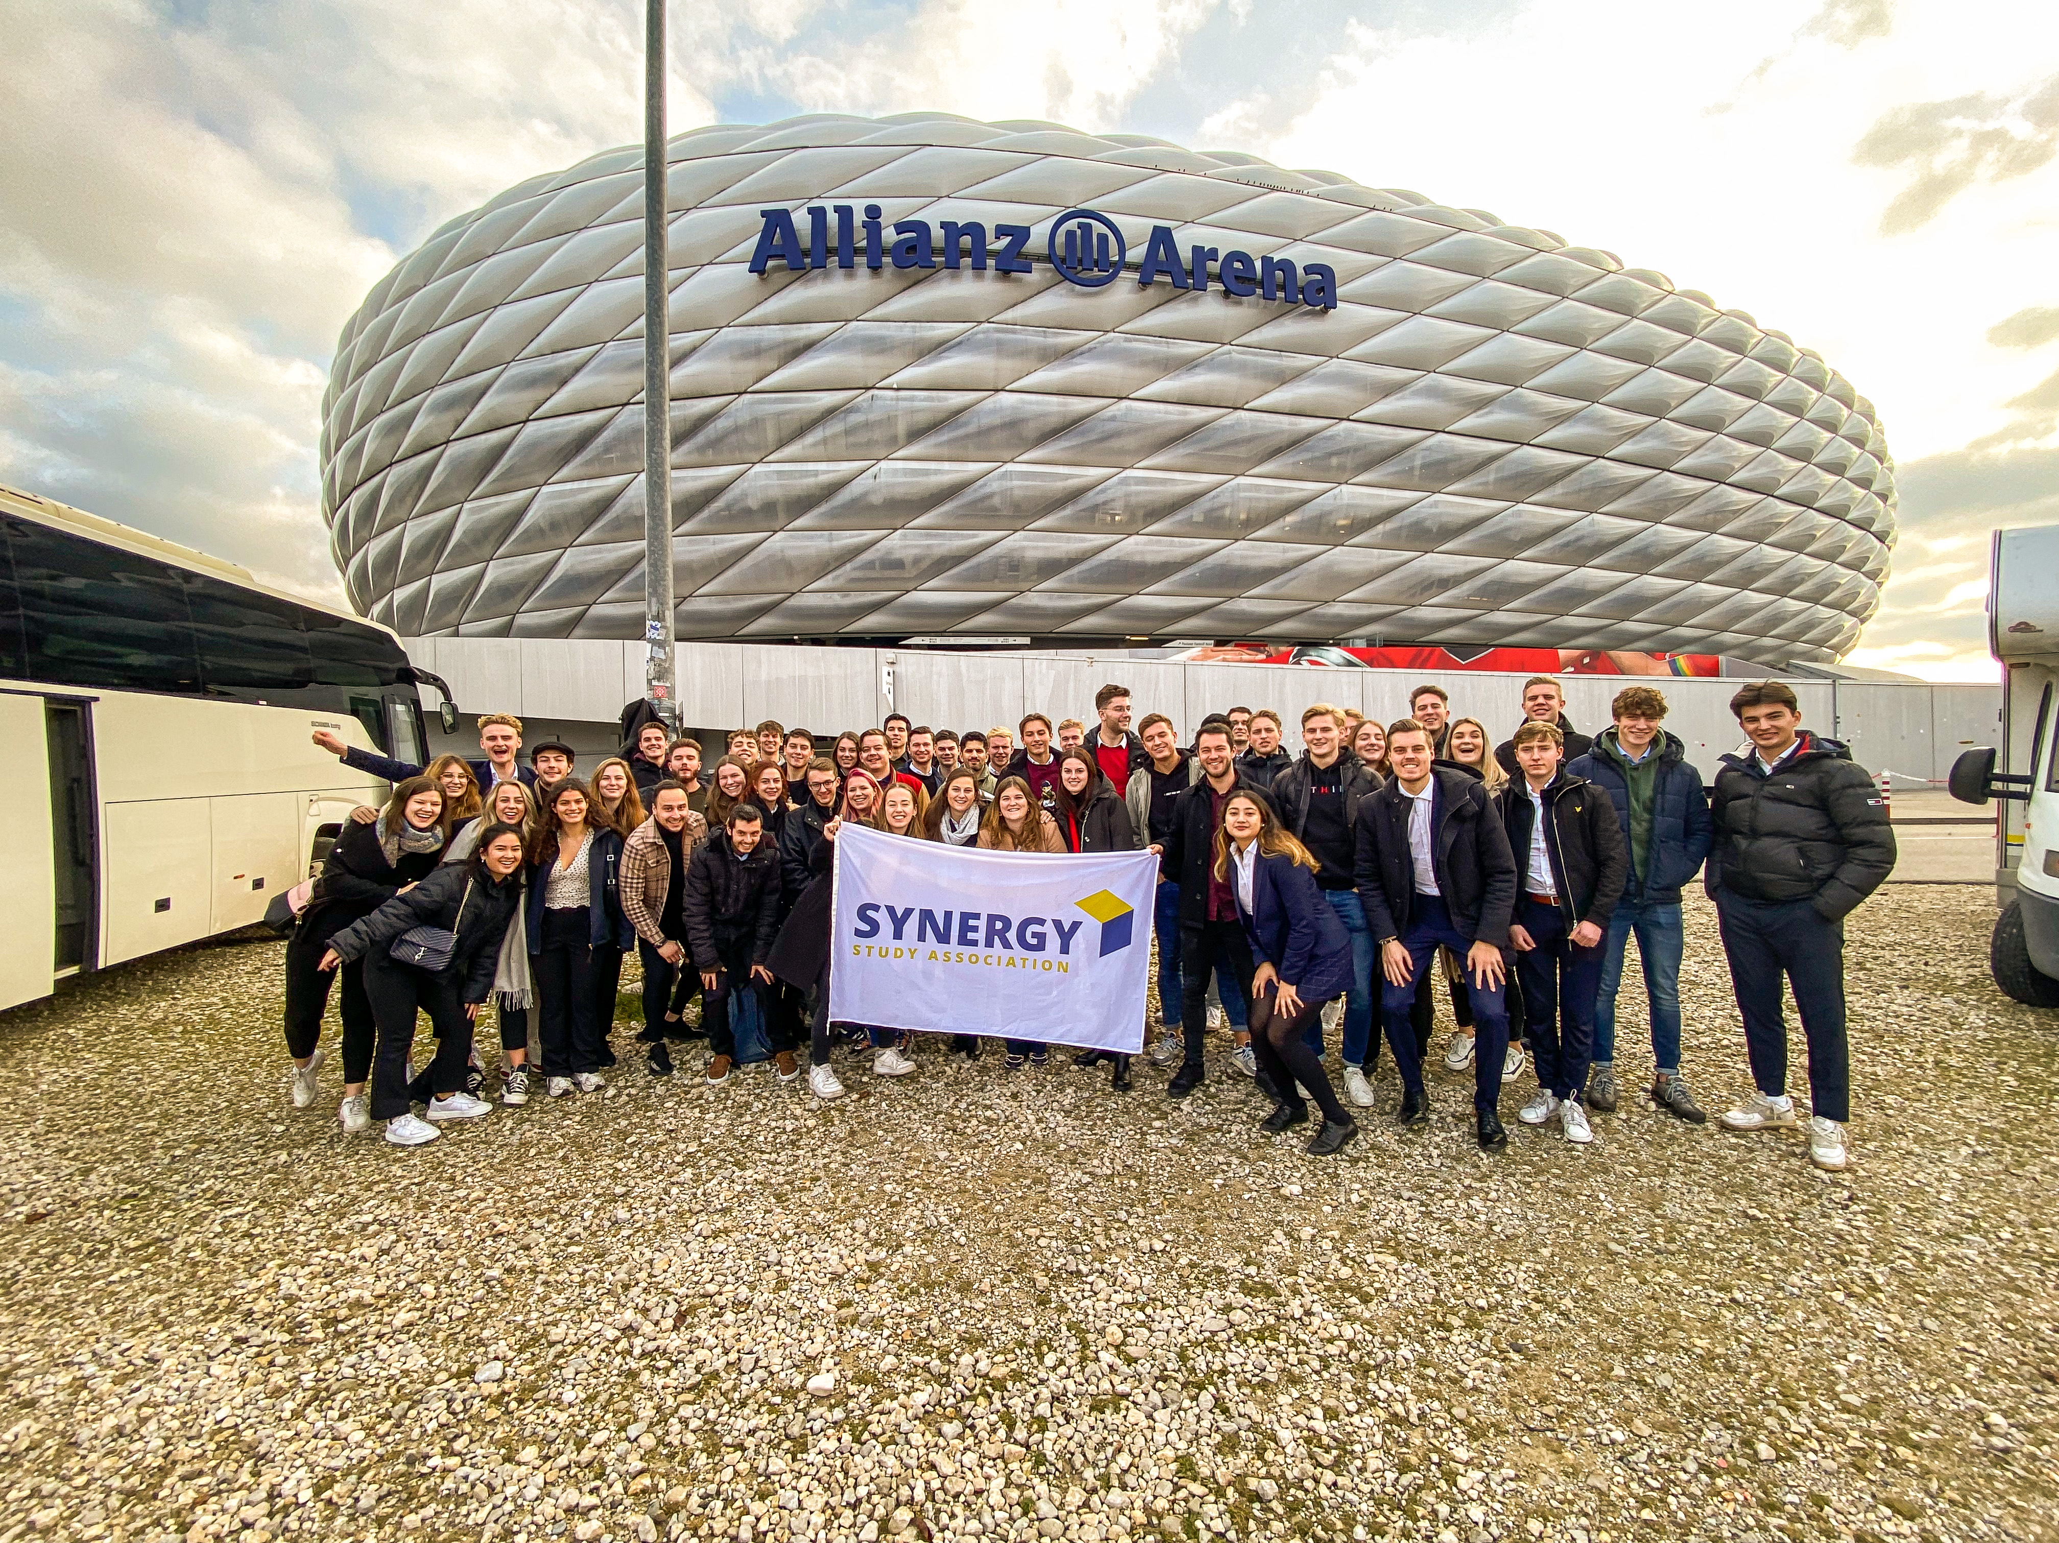
Business Trip Committee
Yearly business trip for 40 people
2/3 days in November
Formal company visits combined with activities
Foreign city!

Slide 10
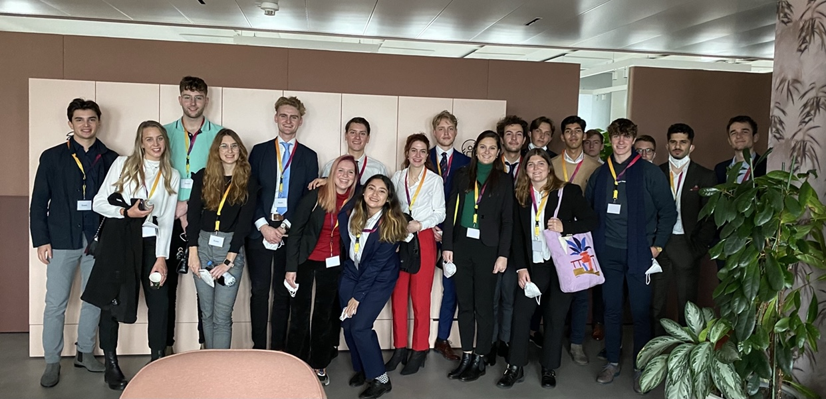
Business Trip Committee
6 committee members (chairman, internal, external, treasurer)
Takes 1 hour a week at first
After summer increasing workload
Enthusiastic, brave committee with high responsibility
Good for your CV, enlarged global network

Slide 11
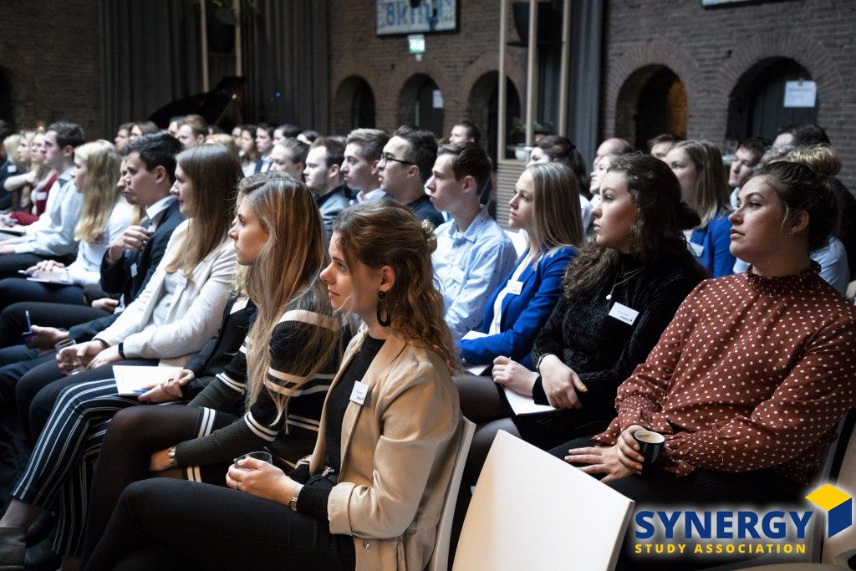
Conference Committee
Organizing a 1-day conference
for fellow students
7 committee members
2-4 hours a week, depending on the time of the year. There is a significant difference between the workload before and after the summer break.

Slide 12
Conference Committee
Arrange location
Get into contact with several companies
Find an interesting speaker
Good for your CV, enlarged network

Slide 13
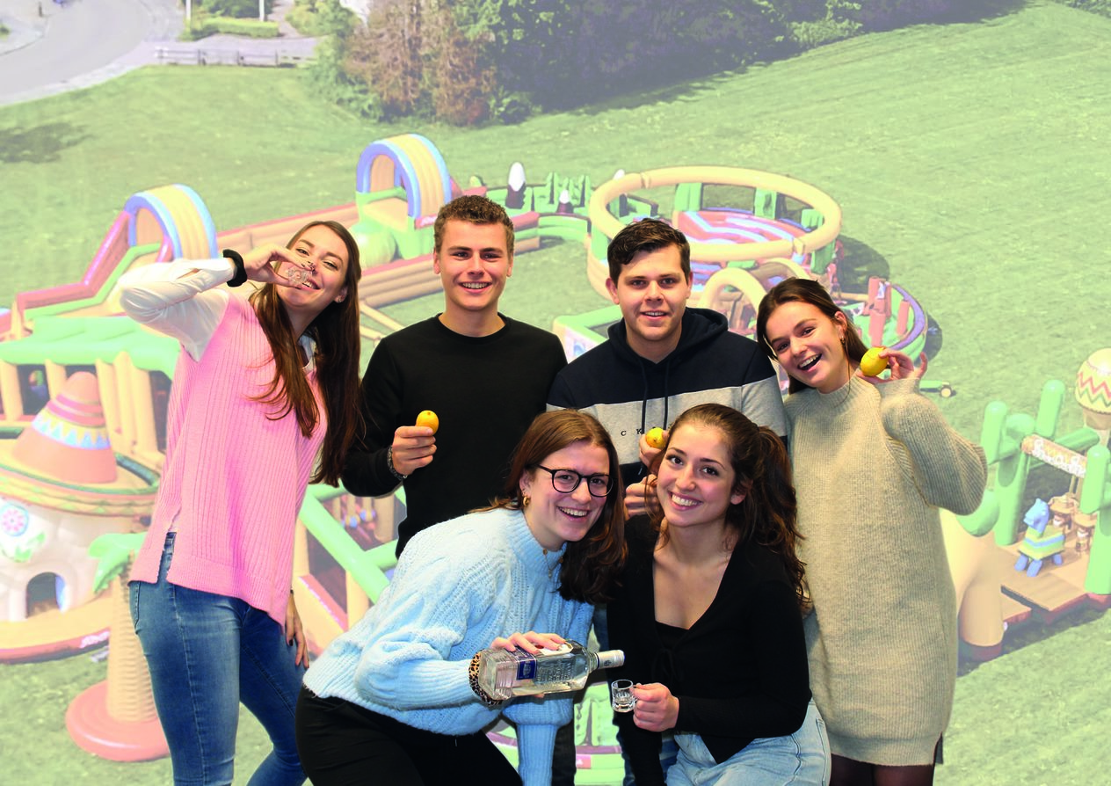
Kick-Off Committee
7 committee members
+/- 13 activities (formal and informal) in October and September.
2 hours a week

Slide 14
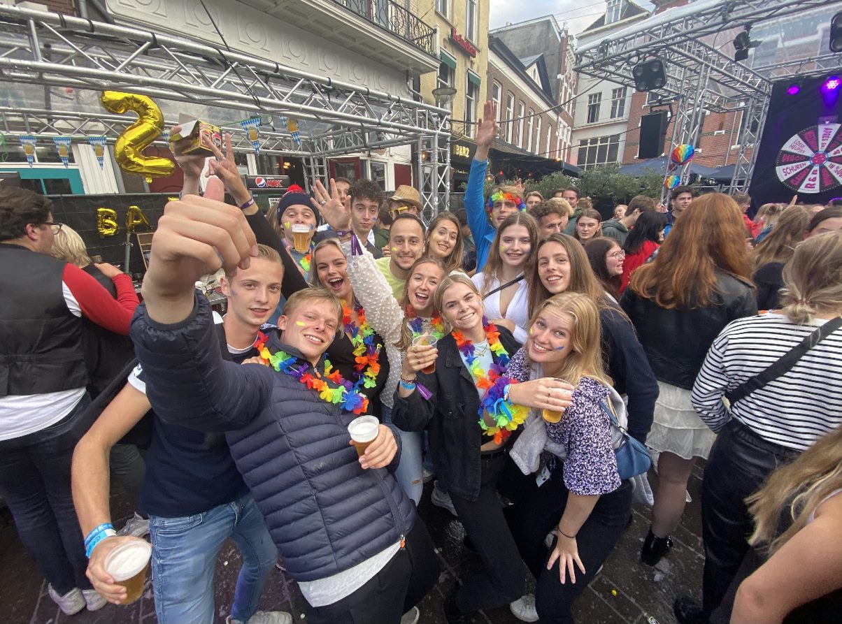
Orientation Week Committee
New students
Orientation week
Berendonck battle
Open BA-party
Beer cantus
Other parties
7 committee members
1 hour a week

Slide 15
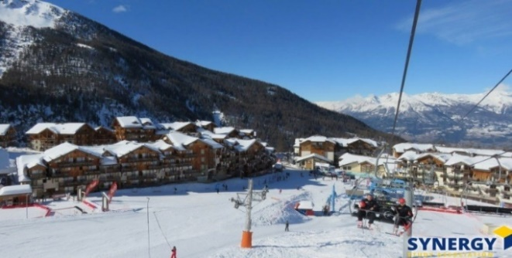
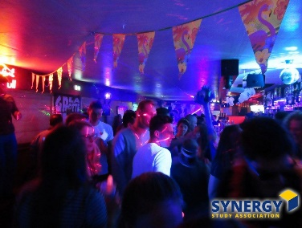
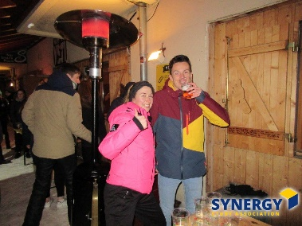
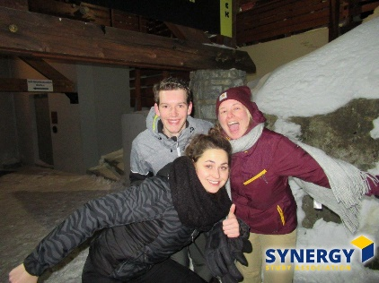
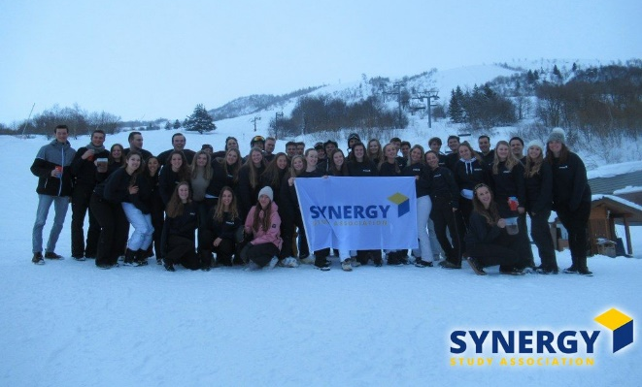
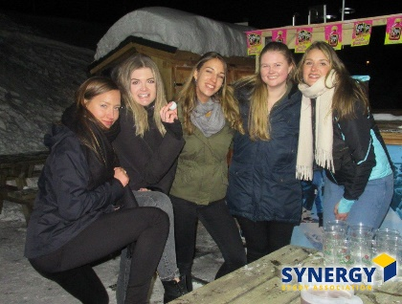
Ski Trip Committee
Organizing a ski trip for 40 people
6 committee members
What do you do: - Location - Evening activities - Introduction activity - Final drink
2 hours a week (depending on the time of the year)

Slide 16
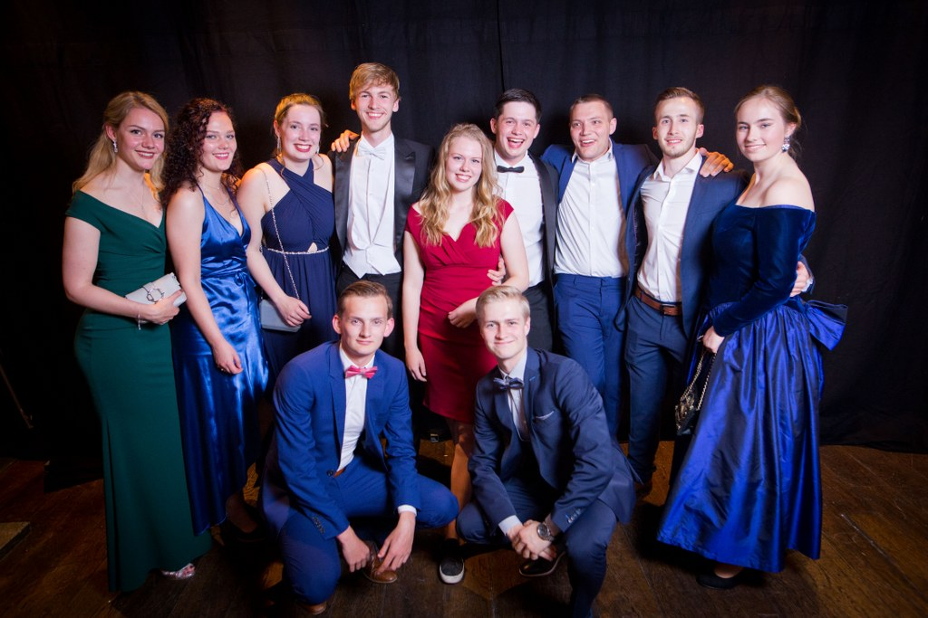
Synergy Week Committee
A week in May full of activities
Formal and Informal activities
Synergy Gala
9 committee members
2-3 hours a week

Slide 17
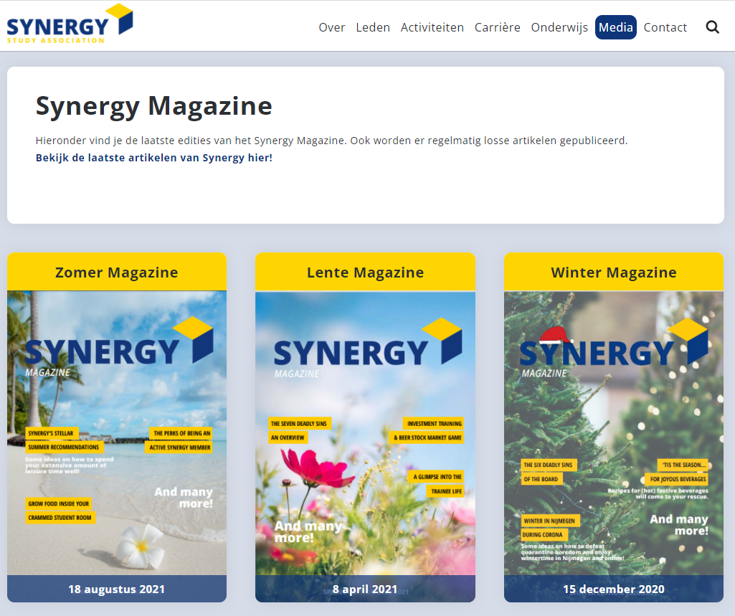
Magazine Committee
Flexibility
Writing for Synergy & companies
Broad topics for a broad study
Write anywhere, anytime
+- 5 committee members
Workload based on when and how much you want to write

Slide 18
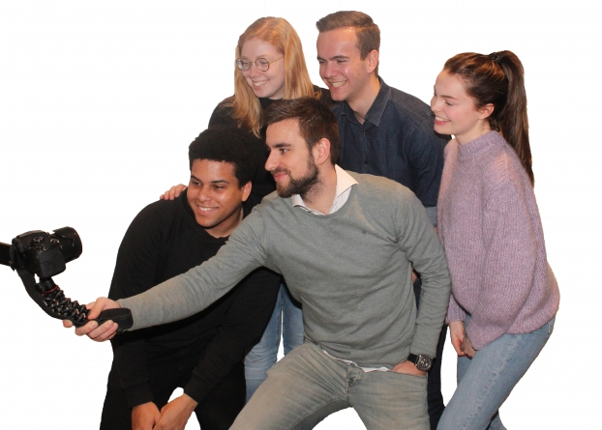
Photo Committee
Making pictures & filming during Synergy activities
Making them ‘website ready’
Free access to the activity you make pictures at
4 committee members (more members possible)
1 to 2 hours a week (based on your availability)
Supportive committee, so you are able to do another committee next to it

Slide 19
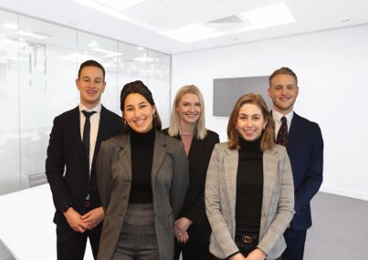
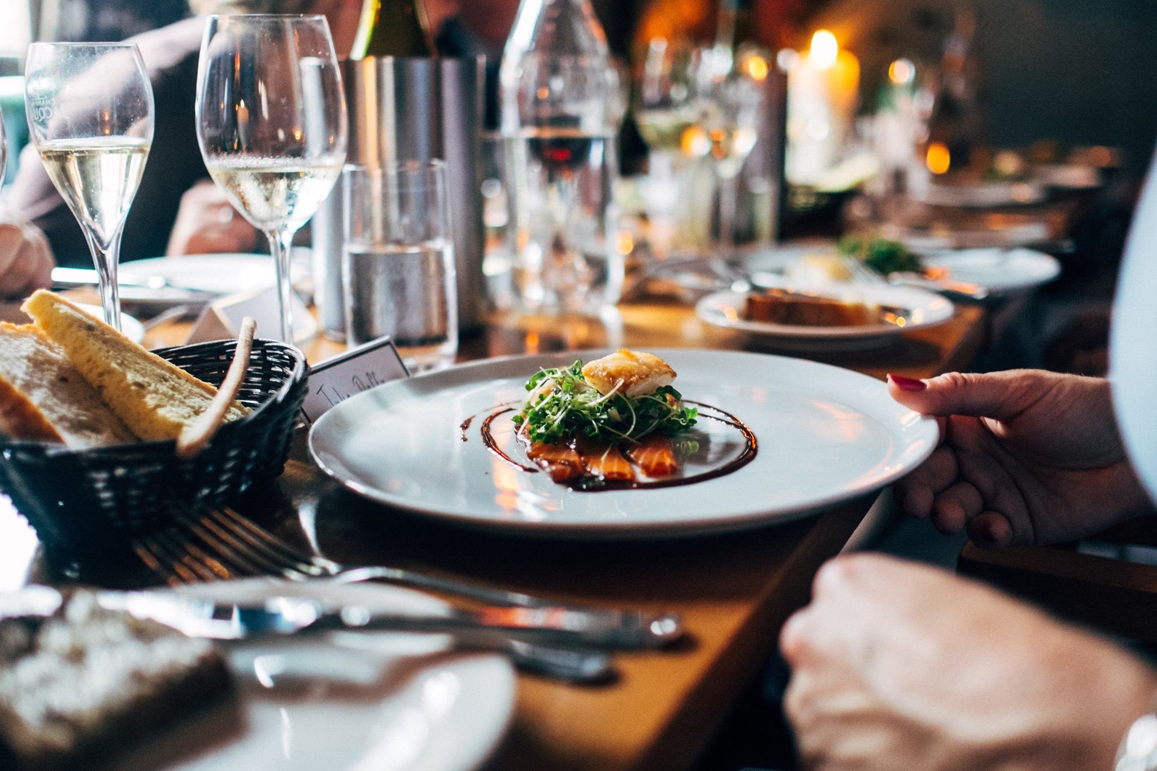
Formal Master Committee
Expand your network by contacting potential future employers
2 recruitment dinners
Formal activities
Looking for chairman
2 hours a week

Slide 20
Community Committee
Do something for society
Community day: choose a charity group, fundraising campaign for Serious Request, RAGweek
5 committee members
Time spend: 0-2 hours a week

Slide 21
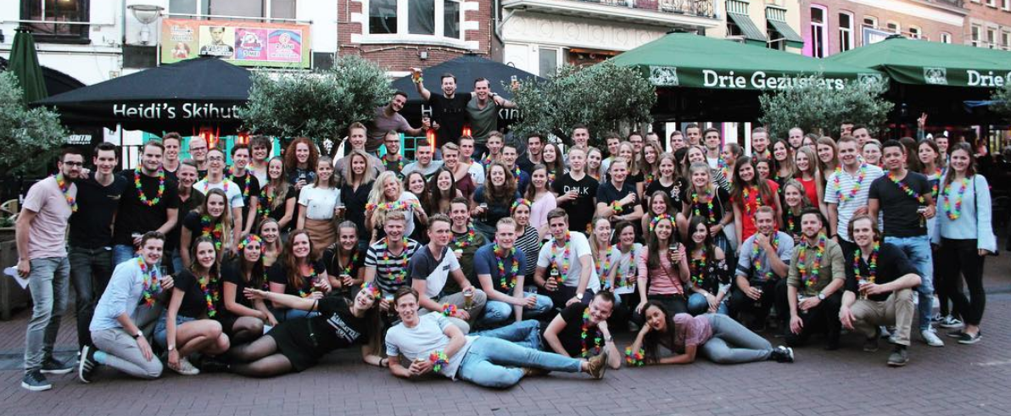
Active Members Activity

Slide 22
Registration Deadline
You can register for a committee from today 16:00h till the 1st of March, 12:00h via our website:
www.synergy.nu/events
You can give up 3 preferences!
If you want to be a chairman of a committee, check that box and send a motivation letter to secretary@synergy.nu

